Slide 1
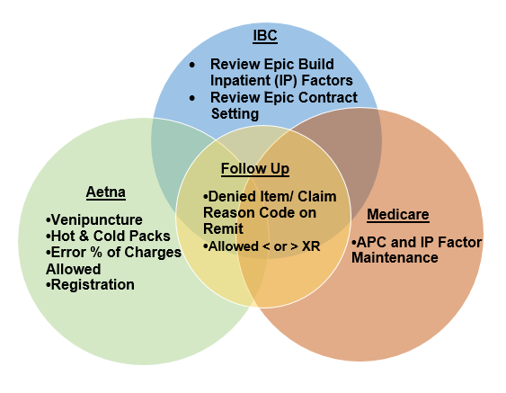
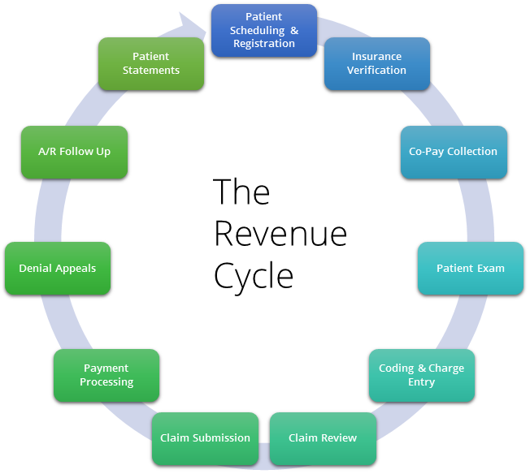
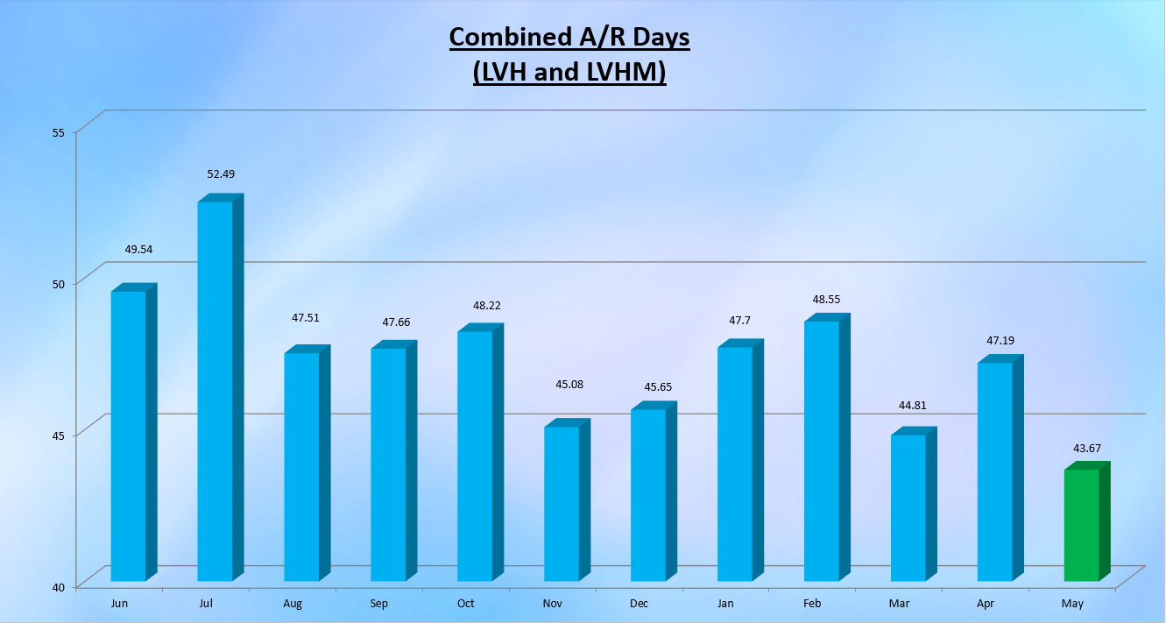
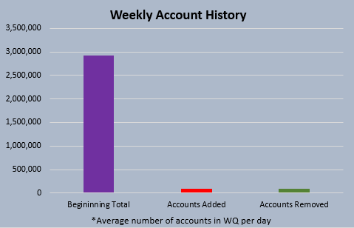
Managing Variances In the Revenue Cycle to Lower Accounts Receivable
Kirsten Hubler and Kirsten Mears
Mentor: Donald Porter
INTRODUCTION
THE REVENUE CYCLE
RESULTS
Accounts Receivable (A/R) consists of the amounts due to the hospital for services rendered. Managing exceptions in the revenue cycle assists in reducing variances and expediting payments. The purpose of this project is to identify common issues in the revenue cycle, offer recommendations for resolutions, and analyze their direct impact on the A/R. This project will highlight contractual considerations for three primary insurance provider types; Blues, Commercial, and Medicare.
The revenue cycle is defined as “All administrative and clinical functions that contribute to the capture, management, and collection of patient service revenue.“₂
Key steps in the revenue cycle are the registration process, coding and charge entry, claim review, payment processing, and patient statement.
These steps encompass generating a bill, defining expected reimbursement, posting payments, and the account closes with successful completion of the collection process.
The revenue cycle is managed in the Epic platform, which contains the electronic medical record (EMR). Epic is a consolidated source of information and has tools to track the revenue cycle process.
Epic is a source of truth for LVHN.
When an error in the revenue cycle occurs a variance is then produced.
A variance is a deviation in the expected reimbursement rate.
Different ways IBC, Aetna, and Medicare affect the billing process and root causes of the variances: (See figure 2)
Variances occur in a variety of different ways within each of the following insurance provider types:
Figure 3. Variance Results
ACCOUNTS RECEIVABLE
Figure 1. The Revenue Cycle.₃
A/R trends at approximately $600 million gross for Hospital Billing (HB).
Approximately 180 employees in Patient Financial Services (PFS) are responsible with working the A/R balances.
RECOMMENDATIONS
Coordinate and develop channels of communication in the PFS department to address and reduce administrative variances in order to isolate potential build enhancements from true follow up issues.
LVHN will continue to provide and develop educational resources as well as Revenue Quality Assurance (RQA) updates to implement proper registration skills.
Continue to develop payor relationships to identify and resolve project and or multiple claim issues.
PFS goal was 42.5 days on the A/R for the fiscal year ending June 30th, 2017.
The PFS team maintains the focus to lower days on the A/R.
Chart 1. Combined A/R Days₁
COMPARING VARIANCES
© LVHN, 2017
Chart 2. Weekly History
Work queues are tools used to delineate responsibilities to the PFS team.
Approximately 90,000 new claims are added and a similar number of existing claims drop off from work queues on a weekly basis.
A single claim can exist in multiple work queues.
IBC©
Fee For service schedule
Carve Out
AETNA©
Outpatient percent of charges
Defined Diagnosis-related Group (DRG) rates
MEDICARE
Outpatient Reimbursement is Ambulatory Procedure Classification (APC)
Psych, Neonatal Intensive Care Unit (NICU), Burn, etc….
CMS/DRG against commercial rates
Inpatient DRG
Multiple regional and facility factors
Multiple product offerings
Figure 2. Examine three insurance providers.

Slide 2
Back of Poster
Patient Financial Services. (2017). Monthly Summary (pp. 1-40, Rep.). Allentown, PA : Lehigh Valley Health Network.(Chart 2)
Revenue Cycle. (n.d.). Retrieved July 12, 2017, from https://ohsu.edu/xd/about/services/patient-business-services/revenue-cycle/
Revenue Cycle Management. (n.d.). Retrieved July 12, 2017, from http://www.ihealth-solutions.com/rcm/ (Figure 1)

